Slide 1

Safe Learning in Robotics:
From Learning-Based Control to Safe Reinforcement Learning
24.07.03
Kangyeon Kim, Hyeongchan Ham

Slide 2
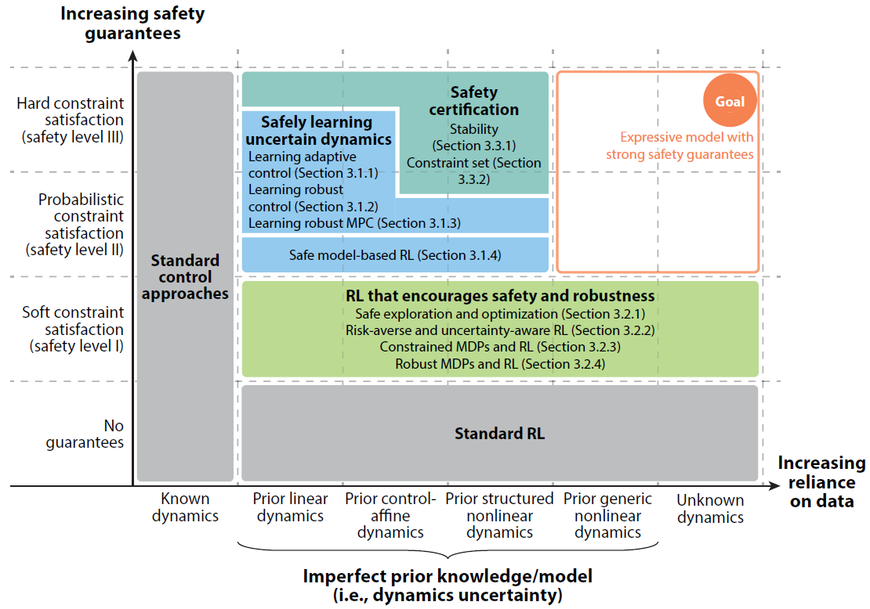
1. Summary of the safe learning control approaches

Slide 3
2. List
1) Learning Uncertain Dynamics to Safely Improve Performance: 4
2) Encouraging Safety and Robustness in Reinforcement Learning: 7
3) Certifying Learning-Based Control Under Dynamics Uncertainty: 2

Slide 4
2. List
1) Learning Uncertain Dynamics to Safely Improve Performance
Sec 1. Integrating ML and adaptive control
Sec 2. Learning-based robust control
Sec 3. Reducing conservatism in robust MPC with learning and adaptation
Sec 4. Safe model-based RL with a priori dynamics

Slide 5
2. List
1) Learning Uncertain Dynamics to Safely Improve Performance
Sec 3. Reducing conservatism in robust MPC with learning and adaptation - 1
Title: Learning model predictive control for iterative tasks. a data-driven control framework
(TAC, 2018)
Author: Rosolia U, Borrelli F.
Cited by: 376
Code(?, learning in mpc): https://sites.google.com/berkeley.edu/lmpc/home
코드 관련 형찬 코멘트:
- python2.7 사용, 호환성 문제.
- docker 환경 제공해줘서 편하긴 하지만, docker 사용법 알아야 함.
Notes:
55 in sup

Slide 6
2. List
1) Learning Uncertain Dynamics to Safely Improve Performance
Sec 3. Reducing conservatism in robust MPC with learning and adaptation - 2
Title: Data-efficient reinforcement learning with probabilistic model predictive control
(AISTATS, 2018)
Author: Kamthe S, Deisenroth M.
Cited by: 276
Code(unofficial): https://github.com/SimonRennotte/Data-Efficient-Reinforcement-Learning
-with-Probabilistic-Model-Predictive-Control
코드 관련 형찬 코멘트:
- 실험 분석 툴 많아서 활용성이 좋음.
Notes:
62 in sup

Slide 7
2. List
1) Learning Uncertain Dynamics to Safely Improve Performance
Sec 3. Reducing conservatism in robust MPC with learning and adaptation - 3
Title: Learning-based model predictive control for safe exploration and reinforcement learning
(CDC, 2018)
Author: Koller T, Berkenkamp F, Turchetta M, Boedecker J, Krause A.
Cited by: 465
Code: https://github.com/befelix/safe-exploration
코드 관련 형찬 코멘트:
- document 없어서 코드 분석하기 어려움.
- docker 환경 제공해줘서 편하긴 하지만, docker 사용법 알아야 함.
Notes:
63 in sup

Slide 8
2. List
1) Learning Uncertain Dynamics to Safely Improve Performance
Sec 4. Safe model-based RL with a priori dynamics - 1
Title: Safe Model-based Reinforcement Learning with Stability Guarantees (NIPS, 2017)
Author: Berkenkamp F, Turchetta M, Schoellig A, Krause A.
Cited by: 981
Code: https://github.com/befelix/safe_learning
코드 관련 형찬 코멘트:
- example notebook 파일 있어서 이해하기 좋음.
- docker 환경 제공해줘서 편하긴 하지만, docker 사용법 알아야 함.
Notes:
66 in sup

Slide 9
2. List
2) Encouraging Safety and Robustness in Reinforcement Learning
Sec 1. Safe exploration and optimization
Sec 2. Risk-averse RL and uncertainty-aware RL
Sec 3. Constrained MDP and RL
Sec 4. Robust MDP and RL

Slide 10
2. List
2) Encouraging Safety and Robustness in Reinforcement Learning
Sec 1. Safe exploration and optimization - 1
Title: Safe exploration in finite Markov decision processes with Gaussian processes (NIPS, 2016)
Author: Turchetta M, Berkenkamp F, Krause A.
Cited by: 228
Code: https://github.com/befelix/SafeMDP
코드 관련 형찬 코멘트:
- document 따로 있어서 이해하기 좋음.
Notes:
67 in sup

Slide 11
2. List
2) Encouraging Safety and Robustness in Reinforcement Learning
Sec 1. Safe exploration and optimization – 2, 3
Title: Safe exploration for optimization with Gaussian processes. (ICML, 2015)
Author: Sui Y, Gotovos A, Burdick J, Krause A.
Cited by: 416
Title: Bayesian optimization with safety constraints: Safe and automatic parameter tuning in robotics.
(Machine Learning, 2023)
Author: Berkenkamp F, Krause A, Schoellig AP.
Cited by: 284
Code: https://github.com/befelix/SafeOpt
코드 관련 형찬 코멘트:
- document 따로 있어서 이해하기 좋음.
- docker 환경 제공해줘서 편하긴 하지만, docker 사용법 알아야 함.
- 코드 유지되지 않고 있음. (옛날 코드)
Notes:
76,77 in sup

Slide 12
2. List
2) Encouraging Safety and Robustness in Reinforcement Learning
Sec 1. Safe exploration and optimization - 4
Title: Recovery RL: Safe reinforcement learning with learned recovery zones (RA-L, 2021)
Author: Thananjeyan B, Balakrishna A, Nair S, Luo M, Srinivasan K, et al.
Cited by: 211
Code: https://github.com/abalakrishna123/recovery-rl
코드 관련 형찬 코멘트:
- document 없어서 코드 분석하기 어려움.
Notes:
82 in sup

Slide 13
2. List
2) Encouraging Safety and Robustness in Reinforcement Learning
Sec 1. Safe exploration and optimization - 5
Title: Conservative Q-Learning for Offline Reinforcement Learning (NIPS, 2020)
Author: Kumar A, Zhou A, Tucker G, Levine S.
Cited by: 1598
Code: https://github.com/aviralkumar2907/CQL
코드 관련 형찬 코멘트:
- rlkit, d4rl 프레임워크 사용해서 좋음. (잘 알려져서)
Notes:
84 in sup

Slide 14
2. List
2) Encouraging Safety and Robustness in Reinforcement Learning
Sec 3. Constrained MDP and RL - 1
Title: Constrained Policy Optimization (ICML, 2017)
Author: Achiam J, Held D, Tamar A, Abbeel P.
Cited by: 1422
Code: https://github.com/jachiam/cpo
코드 관련 형찬 코멘트:
- rllab 프레임워크 사용해서 좋음. (잘 알려져서)
Notes:
32 in sup

Slide 15
2. List
2) Encouraging Safety and Robustness in Reinforcement Learning
Sec 4. Robust MDP and RL - 1
Title: Active domain randomization (CoRL, 2020)
Author: Mehta B, Diaz M, Golemo F, Pal CJ, Paull L.
Cited by: 244
Code: https://github.com/montrealrobotics/active-domainrand
코드 관련 형찬 코멘트:
- 설치 안내 문서가 부족해서 환경설정 어려울 수도 있음.
Notes:
105 in sup

Slide 16
2. List
3) Certifying Learning-Based Control Under Dynamics Uncertainty
Sec 1. Stability certification
Sec 2. Constraint set certification

Slide 17
2. List
3) Certifying Learning-Based Control Under Dynamics Uncertainty
Sec 1. Stability certification - 1
Title: The Lyapunov neural network: Adaptive stability certification
for safe learning of dynamical systems(CoRL, 2018)
Author: Richards SM, Berkenkamp F, Krause A.
Cited by: 262
Code: https://github.com/befelix/safe_learning
코드 관련 형찬 코멘트:
- example notebook 파일 있어서 이해하기 좋음.
- docker 환경 제공해줘서 편하긴 하지만, docker 사용법 알아야 함.
Notes:
110 in sup

Slide 18
2. List
3) Certifying Learning-Based Control Under Dynamics Uncertainty
Sec 2. Constraint set certification - 2
Title: End-to-end safe reinforcement learning through barrier functions
for safety-critical continuous control tasks (AAAI, 2019)
Author: Cheng R, Orosz G, Murray RM, Burdick JW.
Cited by: 628
Code: https://github.com/rcheng805/RL-CBF
코드 관련 형찬 코멘트:
- matlab 코드.
- 문서가 불친절해서 환경 구현 어려울 수도 있음.
Notes:
125 in sup

